Slide 1
ADVANCED TYPES

Slide 2
TypeScript Intersection Types
An intersection type creates a new type by combining multiple existing types.
The new type has all features of the existing types.
To combine types, you use the & operator as follows:
type typeAB = typeA & typeB;
The typeAB will have all properties from both typeA and typeB.
Note that the union type uses the | operator that defines a variable which can hold a value of either typeA or typeB
let varName = typeA | typeB; // union type

Slide 3
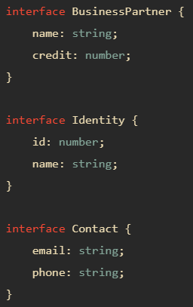

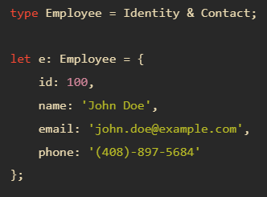
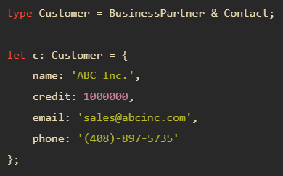
TypeScript Intersection Types

Slide 4

Type Order
When you intersect types, the order of the types doesn’t matter.
In this example, typeAB and typeBA have the same properties.

Slide 5
TypeScript Type Guards
Type Guards allow you to narrow down the type of a variable within a conditional block

Slide 6
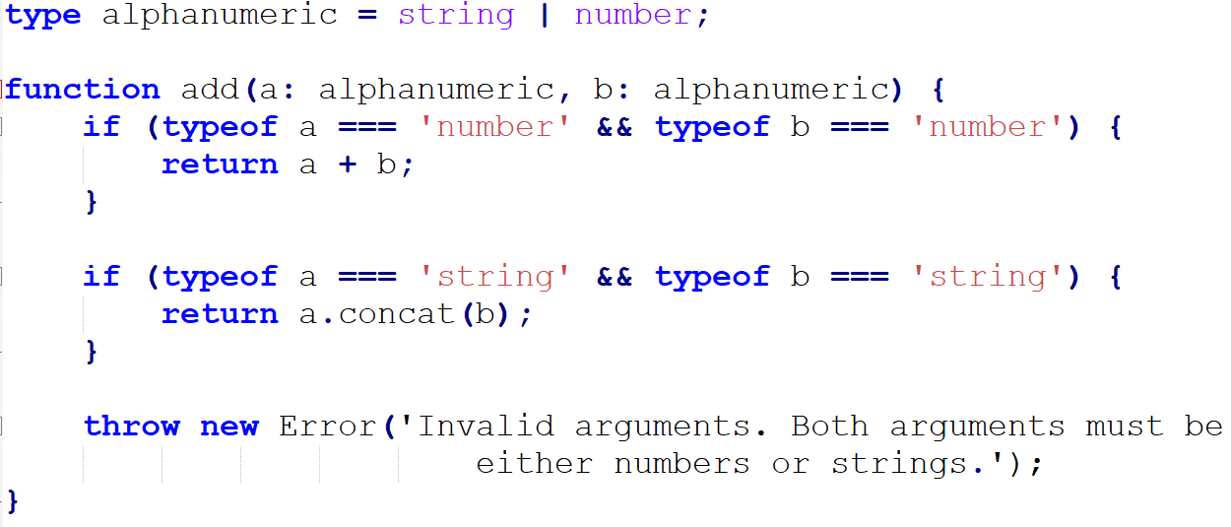


typeof
TypeScript knows the usage of the typeof operator in the conditional blocks.
Inside the following if block, TypeScript realizes that a and b are numbers.
Similarly, in the following if block, TypeScript treats a and b as strings, therefore, you can concatenate them into one

Slide 7
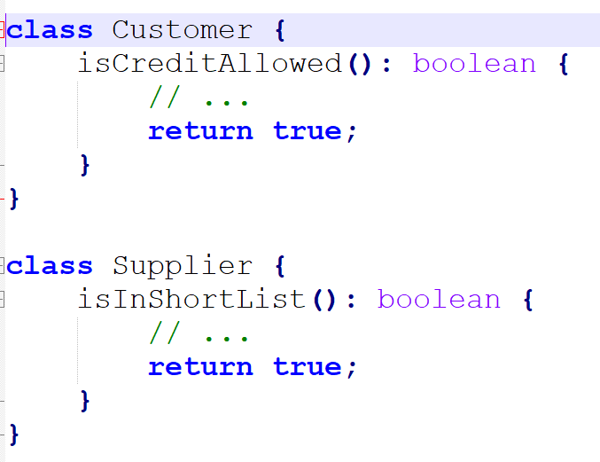
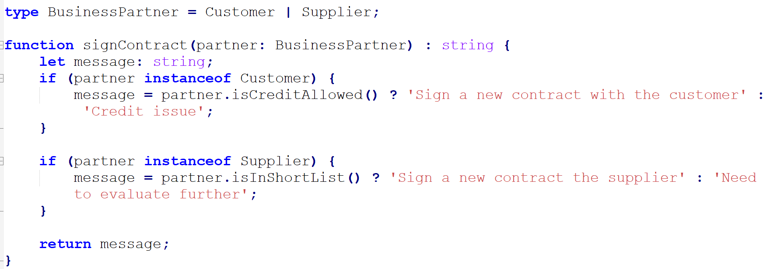
instanceof
Similar to the typeof operator, TypeScript is also aware of the usage of the instanceof operator.

Slide 8
instanceof
TypeScript knows that the partner is an instance of the Customer type due to the instanceof operator
TypeScript knows that the partner is an instance of Supplier inside the following if block

Slide 9
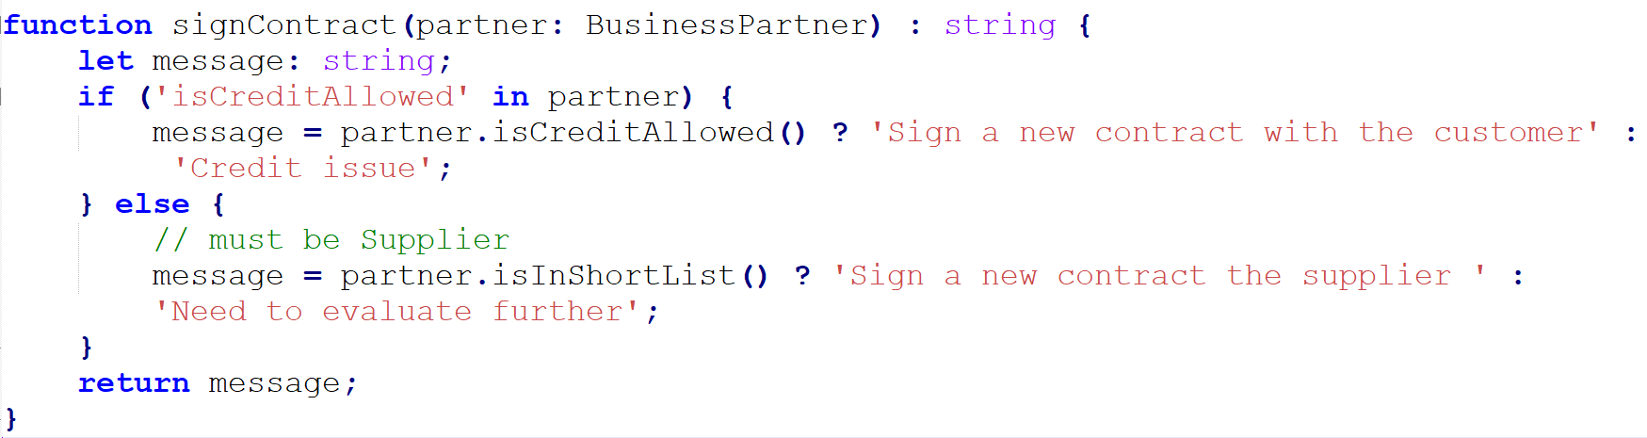
in
The in operator carries a safe check for the existence of a property on an object. You can also use it as a type guard

Slide 10
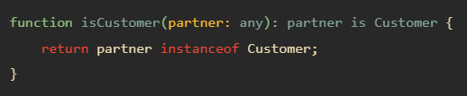
User-defined Type Guards
User-defined type guards allow you to define a type guard or help TypeScript infer a type when you use a function.
A user-defined type guard function is a function that simply returns arg is aType
In this example, the isCustomer() is a user-defined type guard function.

Slide 11
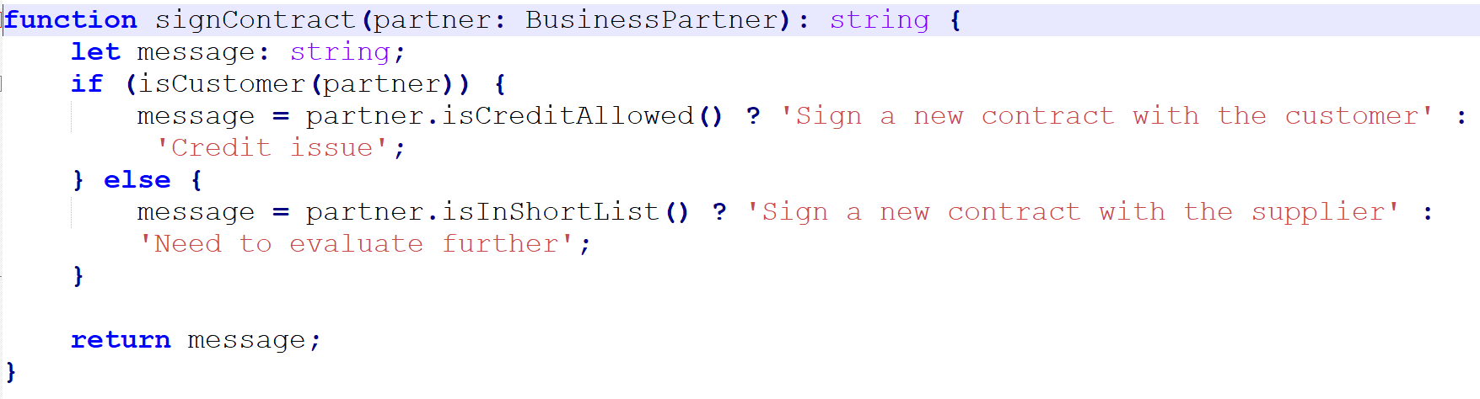
User-defined Type Guards

Slide 12
Type Casting
JavaScript doesn’t have a concept of type casting because variables have dynamic types.
However, every variable in TypeScript has a type.
Type castings allow you to convert a variable from one type to another.
In TypeScript, you can use the as keyword or <> operator for type castings.

Slide 13
Type casting using the as keyword
let input = document.querySelector('input["type="text"]’);
Since the returned type of the document.querySelector() method is the Element type, the following code causes a compiler error:
console.log(input.value);
The reason is that the value property doesn’t exist in the Element type. It only exists on the HTMLInputElement type.
To resolve this, you can use type casting that cast the Element to HTMLInputElement by using the as keyword like this:
let input = document.querySelector('input[type="text"]') as HTMLInputElement;
Now, the input variable has the type HTMLInputElement. So accessing its value property won’t cause any error. The following code works:
console.log(input.value);

Slide 14
Type casting using the as keyword
Another way to cast the Element to HTMLInputElement is when you access the property as follows:
let enteredText = (input as HTMLInputElement).value;
Note that the HTMLInputElement type extends the HTMLElement type that extends to the Element type. When you cast the HTMLElement to HTMLInputElement, this type casting is also known as a down casting.
It’s also possible to carry an down casting. For example:
let el: HTMLElement;
el = new HTMLInputElement();
In this example, the el variable has the HTMLElement type. And you can assign it an instance of HTMLInputElement type because the HTMLInputElement type is an subclass of the HTMLElement type.
The syntax for converting a variable from typeA to typeB is as follows:
let a: typeA;
let b = a as typeB;

Slide 15
Type Casting using the <> operator
Besides the as keyword, you can use the <> operator to carry a type casting. For example:
let input = <HTMLInputElement>document.querySelector('input[type="text"]');
console.log(input.value);
The syntax for type casting using the <> is:
let a: typeA;
let b = <typeB>a;

Slide 16
Type Assertions
Type assertions instruct the TypeScript compiler to treat a value as a specified type. It uses the as keyword to do so
expression as targetType
A type assertion is also known as type narrowing. It allows you to narrow a type from a union type

Slide 17
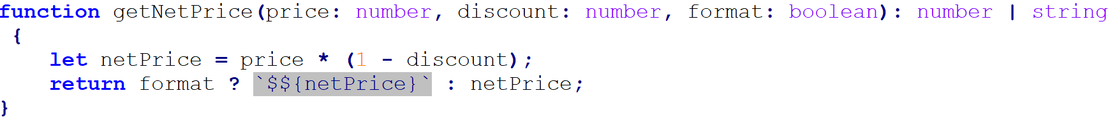


Type Assertions
The getNetPrice() function accepts price, discount, and format arguments and returns a value of the union type number | string.
If the format is true, the getNetPrice() returns a formatted net price as a string. Otherwise, it returns the net price as a number.
The following uses the as keyword to instruct the compiler that the value assigned to the netPrice is a string
the following uses the as keyword to instruct the compiler that the returned value of the getNetPrice() function is a number

Slide 18
The alternative Type Assertion syntax
You can also use the angle bracket syntax <> to assert a type, like this:
<targetType> value
For example:
let netPrice = <number>getNetPrice(100, 0.05, false);
Note that you cannot use angle bracket syntax <> with some libraries such as React. For this reason, you should use the as keyword for type assertions.

